Slide 1
What is going on around my repository?
Cristiano Cesário, Leonardo Murta - {ccesario, leomurta}@ic.uff.br
Instituto de Computação – Universidade Federal Fluminense (UFF)
DyeVC is available at http://gems.ic.uff.br/dyevc

Slide 2
Concept: Distributed x Centralized Repositories
Introduction
Motivation
Related Work
Approach
Conclusion
Workspace
Repository
Repository
clone / pull
check-out / update
check-in / commit
push
Repository
check-out / update
Workspace
check-in
Workspace
Centralized
Distributed

Slide 3
Motivation
Introduction
Motivation
Related Work
Approach
Conclusion
Increasing usage of distributed repositories
Source: Eclipse Foundation. The Open Source Developer Report - 2013 Eclipse Community Survey.

Slide 4
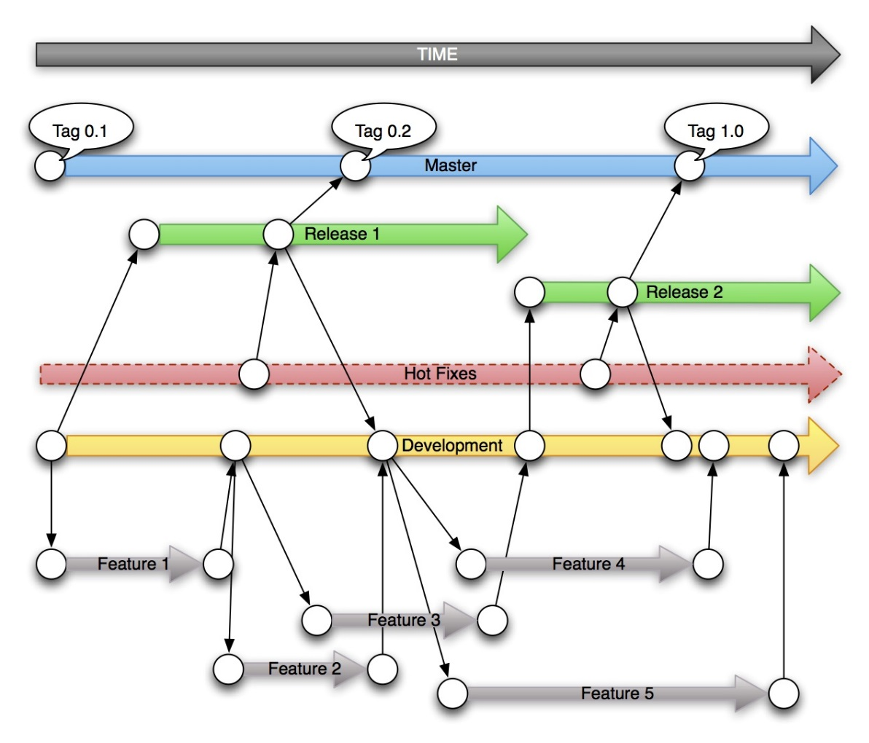
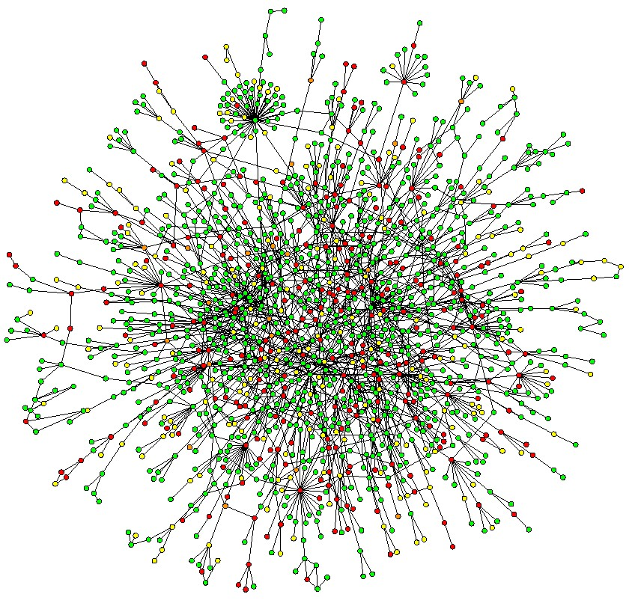
Motivation
Introduction
Motivation
Related Work
Approach
Conclusion
Increasing usage of distributed repositories
Branches
proliferation
Notes:
Proliferação de ramos

Slide 5
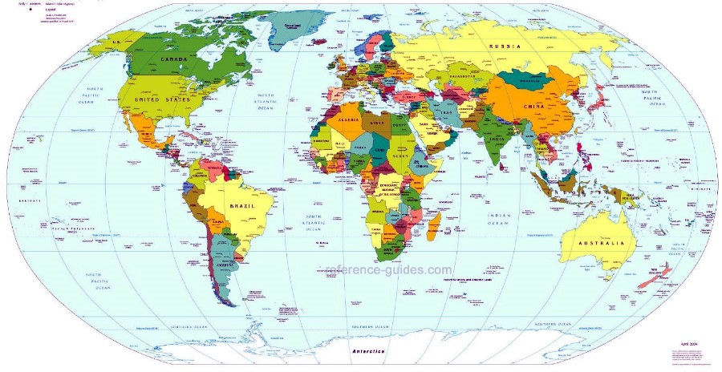
Motivation
Introduction
Motivation
Related Work
Approach
Conclusion
Increasing usage of distributed repositories
Geographic distribution (not only people, but also repositories)
Notes:
Distribuição Geográfica

Slide 6


Motivation
Introduction
Motivation
Related Work
Approach
Conclusion
Difficult collaboration and change awareness
?

Slide 7



Motivation
Introduction
Motivation
Related Work
Approach
Conclusion
Xavier Institute
Wolverine
Storm
Gambit
Professor Xavier
Rogue
Nightcrawler
Cyclops
Jean Gray
Mystique
Beast

Slide 8

Related Work
Introduction
Motivation
Related Work
Approach
Conclusion
Awareness tools
Conflict avoidance
Do not identify related repositories
Do not present information in different levels
SVN Notifier¹, SCM Notifier², Commit Monitor³, SVN Radar⁴ and Hg Commit Monitor⁵
¹http://svnnotifier.tigris.org/ (2012)
²https://github.com/pocorall/scm-notifier (2012)
³http://tools.tortoisesvn.net/CommitMonitor.html (2013)
⁴http://code.google.com/p/svnradar/ (2011)
⁵http://www.fsmpi.uni-bayreuth.de/~dun3/hg-commit-monitor (2009)

Slide 9

Related Work
Introduction
Motivation
Related Work
Approach
Conclusion
Awareness tools
Polvo [Santos and Murta 2012], Palantir, [Sarma and Van der Hoek 2002] CollabVS [Dewan and Hegde 2007], Crystal [Brun et al. 2011], Safe-Commit , Wloka et al. 2009], Lighthouse [Da Silva et al. 2006], WeCode [Guimarães and Silva 2012]
Conflict detecting
Locate only one which supports distributed repositories
Do not support repositories with multiple partners

Slide 10
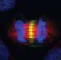
Approach DyeVC*
Introduction
Motivation
Related Work
Approach
Conclusion
DyeVC Database
DyeVC App
DyeVC App
DyeVC App
*Dye over Version Control

Slide 11





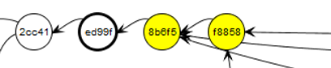
Different Visualization Levels
Introduction
Motivation
Related Work
Approach
Conclusion
Level 1: Repositories
Level 2: Branches
Level 3: Commits

Slide 12
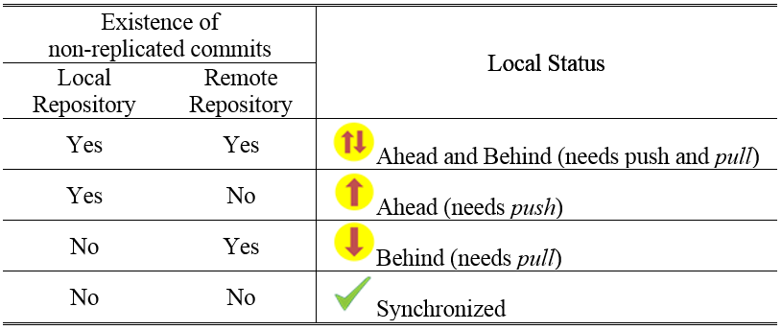
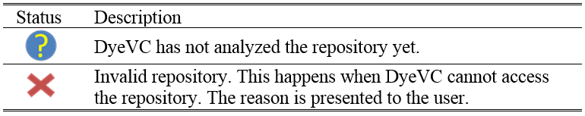
Possible state for a repository
Introduction
Motivation
Related Work
Approach
Conclusion

Slide 13
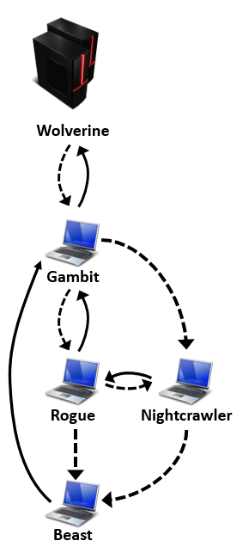
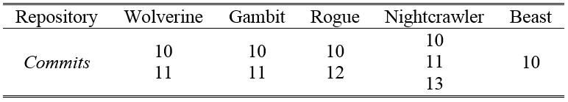
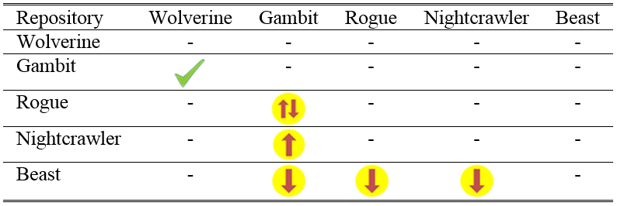
Example
Introduction
Motivation
Related Work
Approach
Conclusion

Slide 14
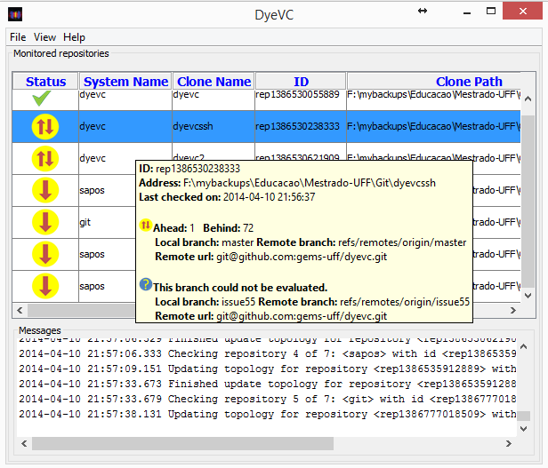
DyeVC - Main Screen
Introduction
Motivation
Related Work
Approach
Conclusion

Slide 15
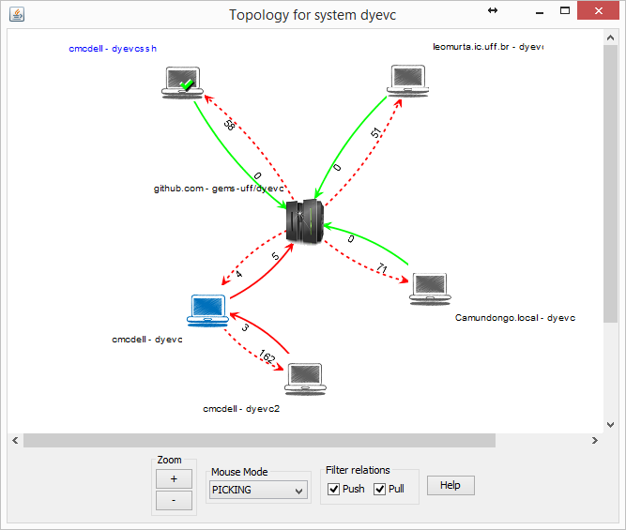
Topology View

Slide 16
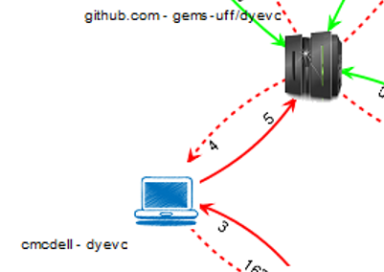
Topology View

Slide 17
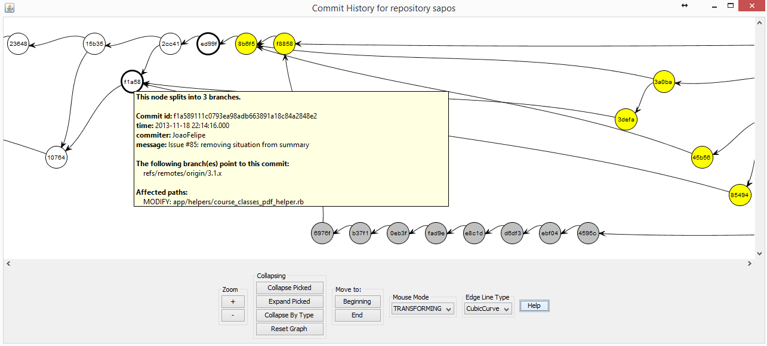
Commit History
Introduction
Motivation
Related Work
Approach
Conclusion

Slide 18
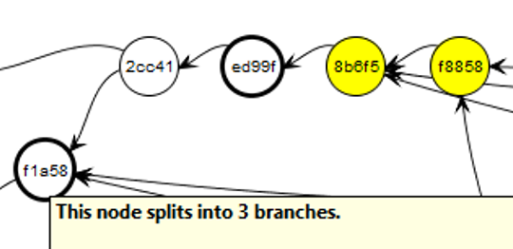
Commit History
Introduction
Motivation
Related Work
Approach
Conclusion

Slide 19


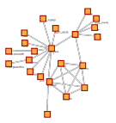

Technology Used
Introduction
Motivation
Related Work
Approach
Conclusion
Java Web Start
Biblioteca JGit
Framework JUNG*
MongoDB
*Java Universal Network/Graph Framework
Notes:
JUNG: Java Universal Network/Graph Framework

Slide 20
Conclusion
Introduction
Motivation
Related Work
Approach
Conclusion
DyeVC é uma ferramenta não intrusiva para visualização de dependências entre repositórios distribuídos
Monitora continuamente os repositórios
Extensível, utilizando o framework JUNG

Slide 21
Trabalhos em Andamento
Introduction
Motivation
Related Work
Approach
Conclusion
Visão topológica dos repositórios

Slide 22
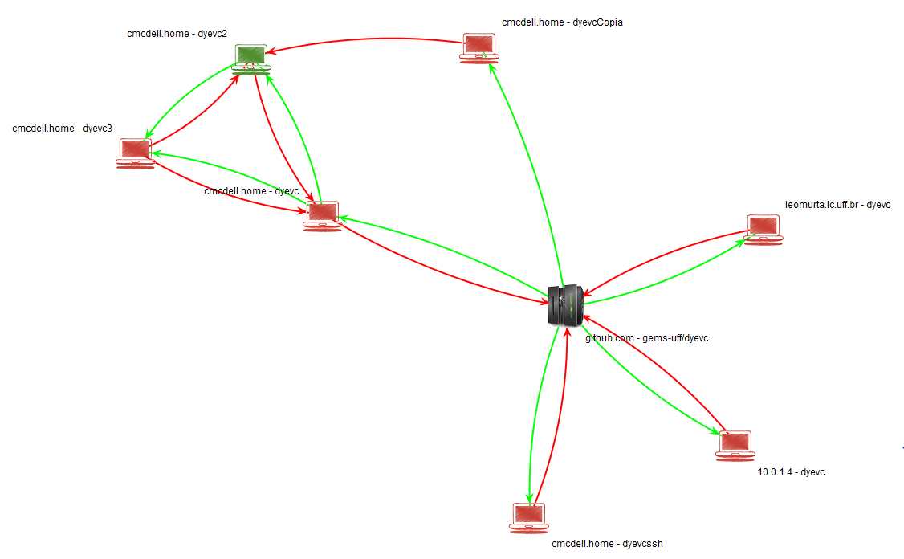
Trabalhos em Andamento
Introduction
Motivation
Related Work
Approach
Conclusion
Visão topológica dos repositórios
Visão completa de commits da topologia

Slide 23
Trabalhos em Andamento
Introduction
Motivation
Related Work
Approach
Conclusion
Visão topológica dos repositórios
Visão completa de commits da topologia
Incorporação de métricas
Commits não pervasivos
Commits que introduziram mais mudanças
Pessoas que alteraram um artefato ou grupo de artefatos
Ramos que causarão conflitos em junções

Slide 24
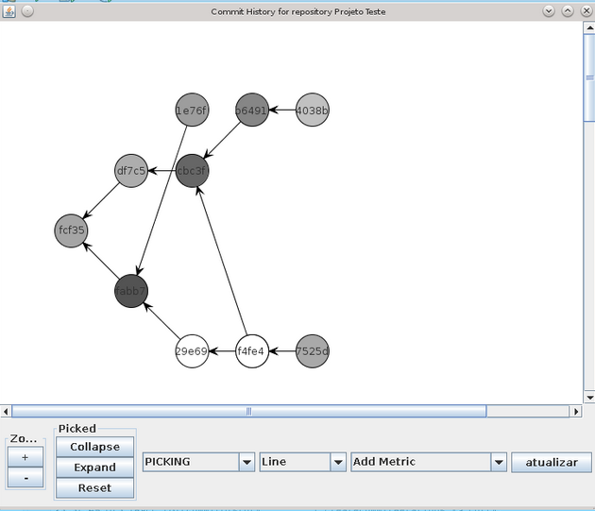
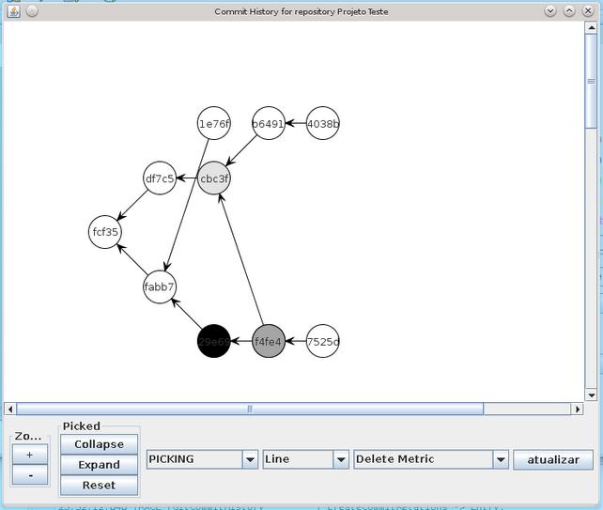
Trabalhos em Andamento
Introduction
Motivation
Related Work
Approach
Conclusion

Slide 25
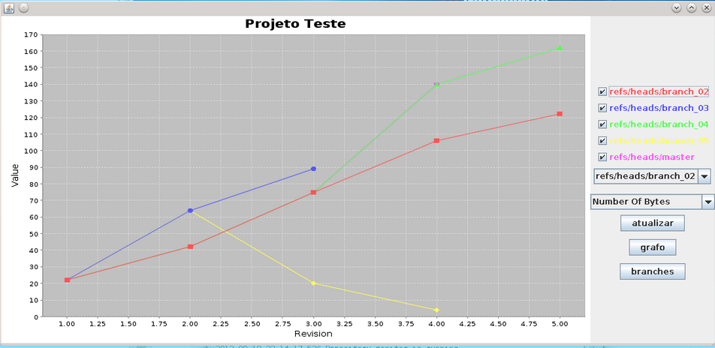
Trabalhos em Andamento
Introduction
Motivation
Related Work
Approach
Conclusion

Slide 26
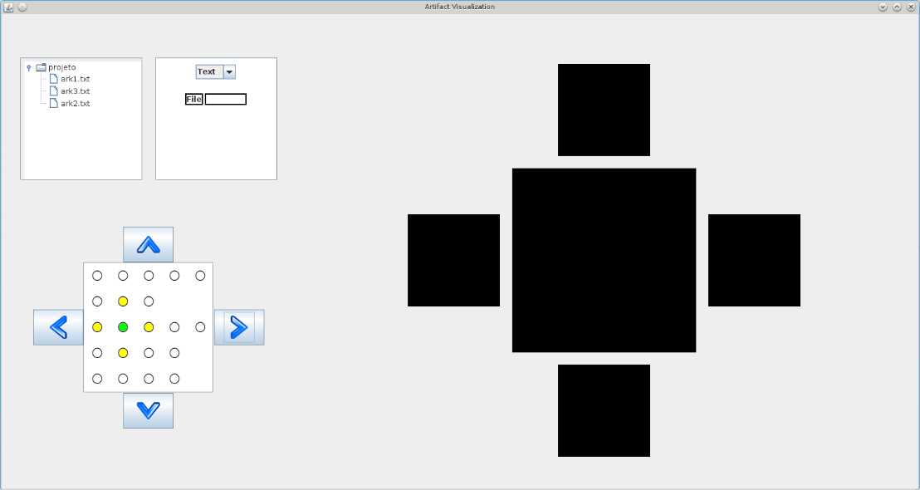
Trabalhos em Andamento
Introduction
Motivation
Related Work
Approach
Conclusion

Slide 27
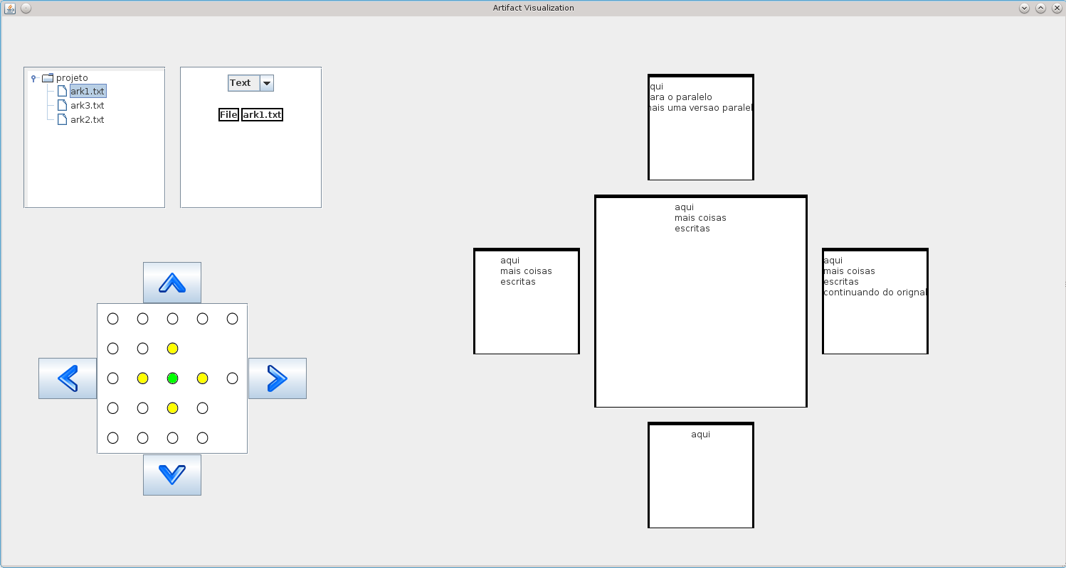
Trabalhos em Andamento
Introduction
Motivation
Related Work
Approach
Conclusion

Slide 28
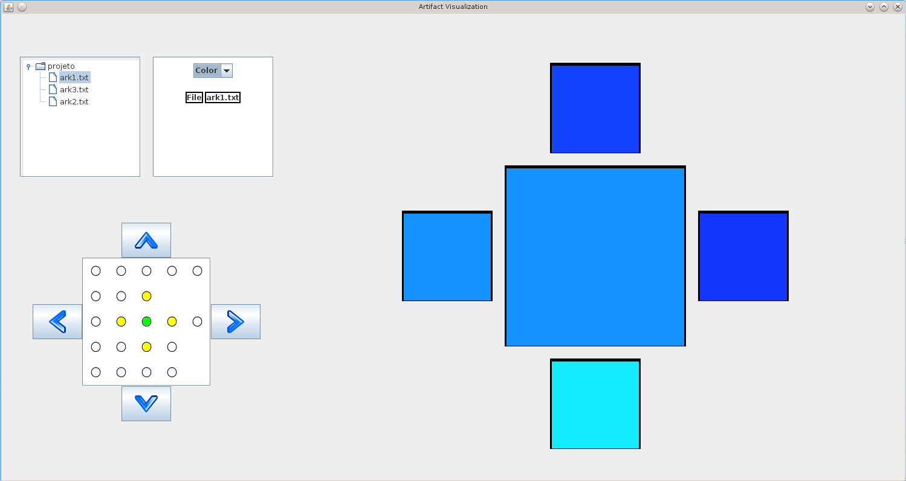
Trabalhos em Andamento
Introduction
Motivation
Related Work
Approach
Conclusion

Slide 29
What is going on around my repository?
Thank You!
Cristiano Cesário, Leonardo Murta - {ccesario, leomurta}@ic.uff.br
Instituto de Computação – Universidade Federal Fluminense (UFF)
DyeVC is available at http://gems.ic.uff.br/dyevc

